Slide 1
Notes:
[OPTIONAL] Cover splash screen that can be displayed at the beginning of an event while people are coming in or logging on. This slide is optional and can be removed if desired.

Slide 2
Family office services
Technology Services

Slide 3


Bringing our Family office service EXPERIENCE TO you
RSM by the numbers
RSM approach
Who we serve
What we offer
Client service philosophy
Holistic strategic advisors focused on helping business owners, executives, and wealthy families strengthen wealth and minimize tax
Best of both worlds with our level of service – personal attention with significant partner involvement enhanced by resources and service capabilities of a global firm
Outsourcing service model
Build strong relationships based on a deep understanding of what matters most to the client
Collaboration and communication are critical – with clients, RSM colleagues, and other professional advisors – in order to identify issues, develop practical solutions, and ensure the proper execution
Utilize standardized procedures across a national practice for efficient and consistent service, including tools for reporting MLP sales, hedge fund K-1s, gift tax returns, etc.
LARGEST
U.S. provider of audit, tax and consulting services to the middle market and ultra high net worth clients
92
years of serving the needs of ultra high net worth clients
Executives
Tax planning and compliance, including compensation programs
Families with diverse assets
  Concentration of private business or public stocks
  Investments in public securities and private ventures
  Unique assets, e.g., artwork, coins, aircraft, etc.
Owner-operated businesses
  From growth and expansion to maturity and succession
Tax compliance and planning – A holistic view of the tax concerns that affect clients, their families, and/or their businesses
Tax reform resources – Online compilation of the perspectives and analysis of our Washington National Tax leaders, industry tax professionals and client advisors
Estate and gift planning – Identification and implementation of multi-generational wealth transfer strategies
Family office services – Assess family needs and identify family office functions and objectives
Owner-operator business structuring and planning – Identification and implementation of the most advantageous business structure for clients and their families
Family education and succession planning – Develop a succession plan that addresses the needs of clients and the future well-being of their families
Comprehensive tax services – In addition to family office services for individuals and families, we have groups that specialize in IRS conflict resolution, state/local and international tax issues for businesses and individuals, plus federal tax for businesses
Technology implementation - Advanced technologies can create efficiencies and provide more opportunities for your family to analyze investment activity and aggregate accounting systems, as well as automate bill paying and other functions.
Improved controls and reporting - Standardized processes generate a bounty of operational meta data. RSM data and analytics professionals can support you in developing solutions to leverage this information to automate controls, reduce review times and provide key metrics to decision makers.
88
private client services partners and senior directors
230
professionals nationwide dedicated to working with ultra high net worth clients

Slide 4



RSM breadth of services
RSM develops multi-generational relationships with family offices by providing tailored advisory services to help sustain the family’s vision in an evolving, digitally driven world
Consulting
Audit
Tax
RSM’s consulting practice provides an extensive range of capabilities and expertise, from infrastructure set-up to strategic planning. Whatever the challenge, RSM can provide the right experts to help determine the right solution.
RSM’s audit practice offers a full-scale line of services to help build, establish and verify trust in your financial reports. We have strict quality standards and deliver a full, fair and independent perspective throughout our services.
RSM tax services helps clients take a comprehensive perspective in a highly-dynamic and complex world of tax to deliver real savings. Our practitioners deliver value by creating a customized, integrated approach for each client to help achieve their specific objectives.
Our consulting services Include:
Our audit services Include:
Our tax services include:
Application and infrastructure support
Business intelligence
Business process improvement
Cost optimization
Finance and accounting outsourcing
Information security
Internal control consulting
IT strategy and optimization
Lease due diligence
Managed services
Operations and supply chain
People and organization optimization
Project management
Telecommunication and Network needs
Managed IT services
Systems integrations
Systems selections
Business Continuity Planning / Disaster Recovery
Asset valuation
Complex debt and equity transactions
Derivatives (hedging)
Discounting and other promotional activities
Exclusivity agreements/purchase commitments
Gift card accounting and related breakage
Incentive
compensation arrangements
Lease accounting
Loyalty programs
Self-insurance
Credits and Incentives
EOTCs
Research and development
TIPS credits
Expenditure analysis
Meals and entertainment
Charitable
Package design costs
Research and development
Leasing
Anchor tenant benefits
Qualified leasehold improvements
Tenant allowances
Fixed assets
Bonus depreciation
Cost segregation
Retail depreciation
TARS
State and local issues
Sales and use
Structuring/planning
Unclaimed property/property tax
International
Tax treaty/withholding comp.
Transfer pricing
VAT/GST

Slide 5
Strategic partner overview
Valuation
Finance and accounting
Charitable giving
Security and privacy
Washington National Tax
Insurance consulting
Technology
Estate, gift, trust
What we provide:
Individual income tax compliance and planning
A holistic view of the tax concerns that affect clients, their families and their businesses
Estate and inheritance planning
Identification and implementation of multi-generational wealth transfer strategies
Global services
Our international private client services advisors understand the multitude of tax considerations impacting taxpayers with a presence in multiple countries.
Comprehensive business tax services
In addition to private client services for individuals and families, we have groups that specialize in conflict resolution with tax authorities, specific local and international tax issues for businesses and individuals
Family office services including education and succession planning
Assess family needs and identify family office functions, objectives, risk and governance
Financial wellness education and planning
Provide education and individual counseling on financial wellness matters including retirement, estate, insurance and overall financial wellness for executives and employees
Philanthropy and nonprofit planning
Devoted team dedicated to providing extensive leadership, management guidance, best practices, and charitable planning expertise
Multidisciplinary strategic advisors
Transaction advisory services
Federal tax
Tax-exempt organizations
International tax
Business succession
State and local tax
Management consulting
Family
governance and education
Notes:
Tony

Slide 6
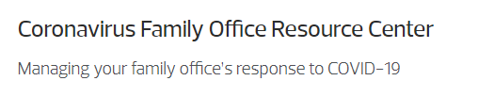

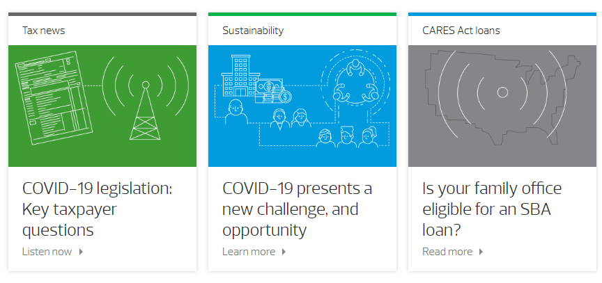
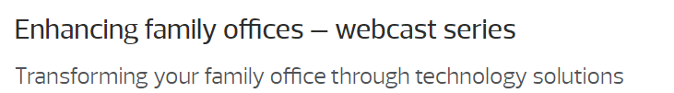
Family office thought leadership
As our way of living has shifted, family offices have gone through a number of transformative changes. RSM is pleased to offer a three-part webcast series exploring how family offices can take a holistic approach to technology ecosystems. We will explore different ways to drive value and growth by leveraging technology, enterprise resource planning tools and tax technology platform, and cover how family offices can maintain awareness of current security threats.

Slide 7
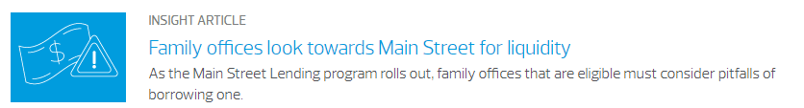

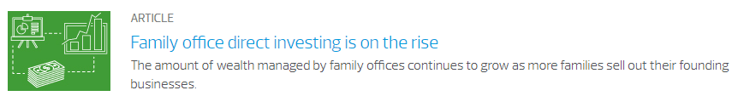
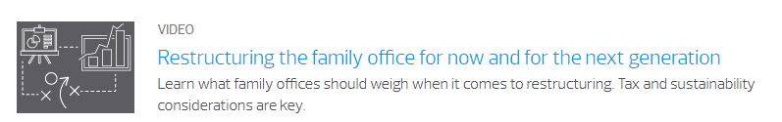
Family office thought leadership/alerts

Slide 8
technology for family offices

Slide 9



Tax function digital transformation
Technology enabled
Tax Function Transformation Workshop
Review and assess current tax function processes and technologies
Define future state processes and the technologies that enable them
Develop your digital strategy and digital transformation roadmap
Data Optimization
Data extraction solutions for high-volume and high labor processes, such as K-1s and 1099s
Data integration and mapping solutions to streamline compliance, reporting, and other data-intensive activities
Data analytics and visualization through dashboard and customized reports to assist with modeling, decision making, and analysis
Digital Toolkit for Tax
Technology selection, deployment, and continuous improvement planning
Automation solutions for repetitive, manual tasks such as REIT testing
Machine learning solutions for complex taxation scenarios such as Sales and Use tax
Data ingestion and extraction solutions for source documents such as invoices, receipts, or contracts
Integration solutions to enable data to flow across systems through the compliance lifecycle
Leverage the RSM Xcelerate and other proprietary technologies as part of our compliance engagements.
Enable your tax function to work more efficiently and meet new regulatory or market challenges through the thoughtful application of technology solutions.
Team with RSM Tax to identify and address immediate needs while working toward a digital transformation roadmap for your organization.
To learn more about RSM’s focus on Tax Innovation, RSMUS.com/Tax Innovation

Slide 10
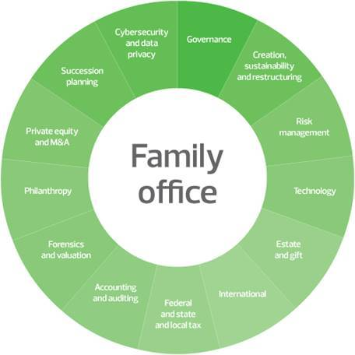
Business process to build outsourced services
8-step process for discovery and analysis
Segregation of Duties
Risk and Control Matrix
7
6
8
Roadmap
Future State Taxonomy
5
.
4
1
Business Requirements Document (BRD)
3
2
Current State Taxonomy
Leading Practice Alignment
Pain Points Analysis

Slide 11
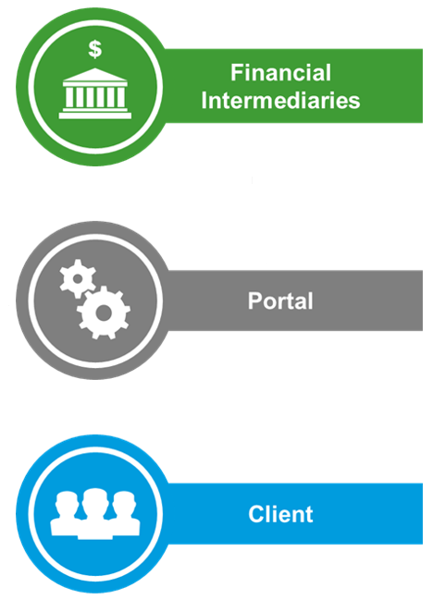
Family office dashboard
The following diagram outlines the core data flow for family office data between RSM’s clients as it pertains to Finance & Accounting Outsourcing and Tax workflows respectively:
Defined focus on tax preparation and reporting
Detail from banks summarized to the client via Financial Statements
Tax Prep Reporting
NPV / Tax Data
SurePrep
Tax Caddy
K-1 Solution
Banks
Blackline
Intacct
Bill.com
PCR
Managed Services
Quick
Books
Netscape
Tamarac
(SPEAR)
Thought Leadership
Insight
Transactions, Reporting & GL
RSM
FO
Investment Performance Reporting
RSM
FAO
Family Office
Client provided with summary of key metrics in financial statement and/or report format, but no advisory is provided by RSM FAO resources
Notes:
Standard content slide with simple bulleted content

Slide 12
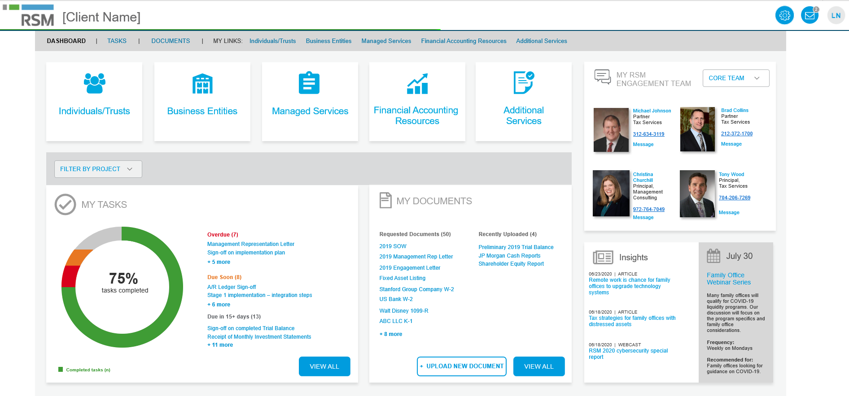

Family office dashboard

Slide 13
Family office dashboard components
Partnership tiering and allocation
Facilitates production of transparent tax estimates, projections and K-1s
Convenient centralized management of investor profiles
Customizable dashboards provide business intelligence and analytics of tax data
Personal and philanthropic
Access to upload and share documents from any computer or mobile device
Connection with major financial institutions to auto-download tax documents
Document storage for current and historical tax returns
Financial aggregation and analytics
Securely consolidates client wealth and asset data across liquid and illiquid investments
Provides powerful and customizable access to wealth data 24/7
Perform data analytics across investments and portfolios
Outsourced CFO capabilities
Integrated solution allowing online bill pay and automated approval process
Segregation of back-office duties to minimize risk
Customizable ERP solution that facilitates monthly/year-end closing

Slide 14
Finance and accounting outsourcing (FAO) overview
RSM’s FAO platform (people, process and technology) is a digital finance and accounting solution that drives finance transformation to enable business success
Comprehensive service to outsource entire back-office accounting function
Delivered leveraging RSM’s digital and people expertise:
Leading cloud-based technology and reporting platform
More than 150 dedicated accounting resources with both industry and accounting expertise
Leverages RSM’s technical accounting, tax and advisory services skills as required
Notes:
Standard content slide with simple bulleted content

Slide 15
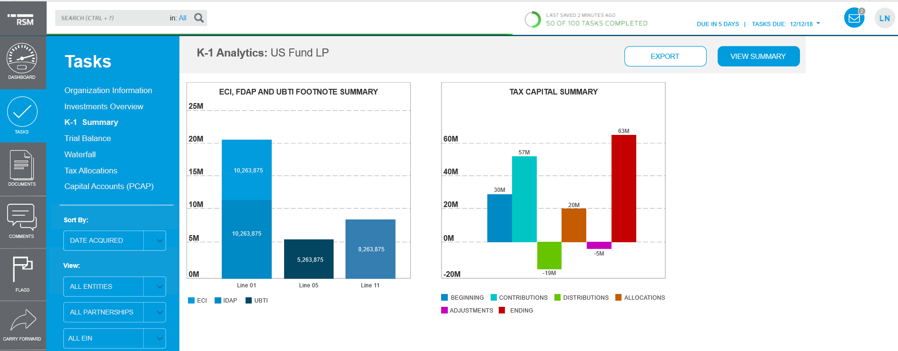

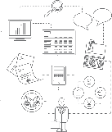
Family office portal components – flexible calculations and analytics
Standard and configurable dashboards provide access to more in-depth analytics
Powerful industry-leading allocation engine
Allocation platform is cloud-based and easily scalable.
Notes:
Standard content slide with simple bulleted content

Slide 16
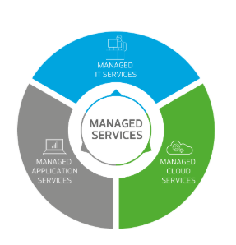
Managed IT services
RSM utilizes our full range of services to develop take a look at your family office technology and determine how it aligns with your needs for accessibility, scalability and reliability.
Our Managed IT services team can provide:
Infrastructure support and/or enhancements
Application installment and support
Technology based security measures.
Dedicated local team members
Security and compliance
Tailored family office solutions

Slide 17




Building a technology-based ecosystem that streamlines collaboration and builds trust
RSM builds and manages a custom suite of API’s and other integrations that automate bi-directional data, analytics and insight sharing between RSM and it’s clients.
FAO
CON
FAMILY MEMBER
AUD
FAMILY MEMBER
FAMILY MEMBER
TAX
ADVISOR
Service can be offered to SFO’s maintaining complete RSM independence and placing SFO in control of entitling and sharing data.
INTEGRATION PLATFORM
REPORT
WEB
SYSTEM
DATA HUB
INTEGRATE
SYSTEM
FOR THE SINGLE FAMILY OFFICE
Leading Total Wealth Aggregation Service including complex illiquid holdings, full operational transparency and privacy management.
SINGLE FAMILY OFFICE
A Complete SFO Proprietary Data Management Eco- System for Acquiring, Sharing and Reporting on Investment and Accounting Data
POWER
BI
A SFO isolated extensible data warehouse and web reporting platform including extensible data model and customizable views and entitlements.
DATA AGG
Pre-packaged and custom integrations to dozens of industry systems (e.g. Tamarac), API access and customizable extracts automate transfer for data.
INVEST
Current Client Base Includes Estimated 400+ Families with Assets of $500M Each
PCR’s award winning UHNW print-ready reporting
INVEST
addresses common family reporting challenges.
TOTAL WEALTH DATA
MANAGEMENT PLATFORM
5

Slide 18
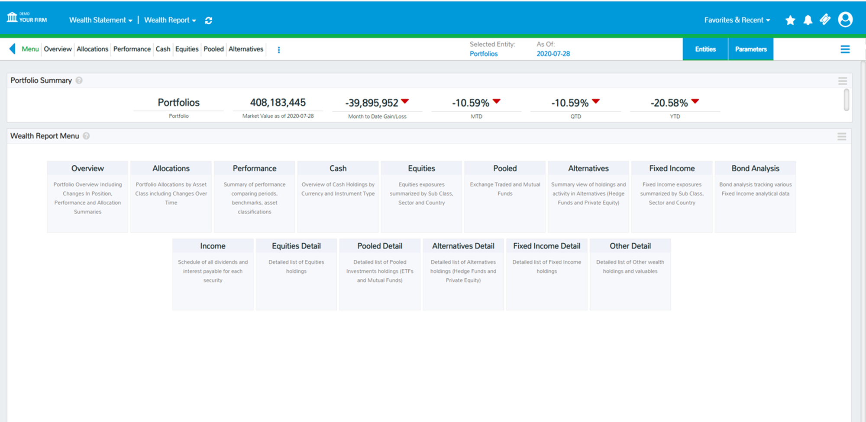
PCR – CWS & Power BI Views

Slide 19
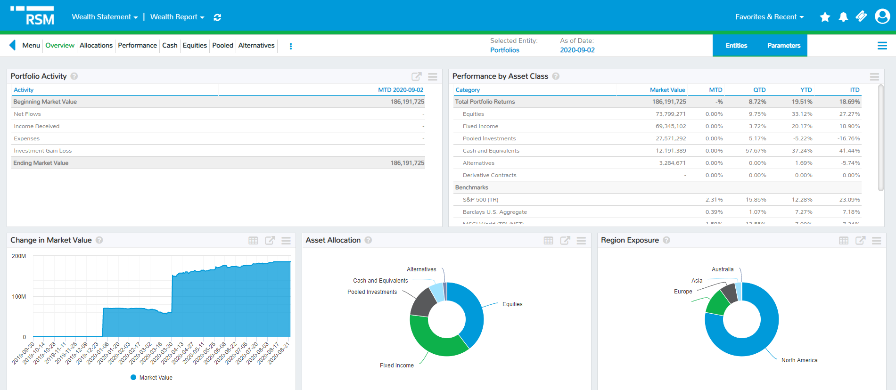

Slide 20
RSM US LLP
+1 800 274 3978
rsmus.com
Notes:
[REQUIRED] This should be displayed at the end of every presentation to cover us from a legal standpoint. Contact information is optional.

